Slide 1
Orange Telecom Churn Analysis
Power BI Analytics Project prepared by Onyinye Shirley Odunze-Akasiugwu
Key KPIs:
• Total Customers: 2,666
• Churned Customers: 388
• Churn Rate: 14.55%
• ARPU: $59.36
• CS Sensitivity Index: 1.41
• Plan Churn Ratio: 3.88

Slide 2
Project Objective
This project analyzes Orange telecom churn using Power BI.
Goals:
• Identify key churn drivers
• Understand behavioral and geographic churn patterns
• Provide insights to improve customer retention
• Visualize churn risk segments for business decisions

Slide 3
Executive Dashboard Insights
• Overall churn rate stands at 14.6%
• International plan customers show significantly higher churn
• ARPU averages $59.36 indicating moderate revenue per user
• CS Sensitivity Index suggests churn increases with service calls
Plan Churn Ratio indicates that International Plan customers are multiple times more likely to cancel their subscriptions, suggesting potential dissatisfaction with pricing or service quality.

Slide 4
Customer Behavior Insights
• Customers with high customer service calls show much higher churn
• Churn risk increases significantly after multiple service complaints
• High call frequency segments have up to ~65% churn probability

Slide 5
Revenue vs Usage Insights
• High usage customers generate more revenue but may still churn
• Cost sensitivity plays a role in churn behavior
• Monitoring high-value customers is critical for retention

Slide 6
Geographic Churn Insights
• Some states show churn rates above 25%
• Regional churn patterns indicate targeted retention opportunities
• Geographic segmentation helps identify at-risk markets

Slide 7
Key Business Recommendations
1. Improve customer support response to reduce repeated service calls
2. Review pricing strategy for international plan users
3. Focus retention campaigns on high-value and high-risk customers
4. Implement proactive churn detection for customers with frequent complaints

Slide 8
Conclusion
Customer churn is strongly influenced by:
• Customer service interactions
• Pricing of international plans
• Customer tenure and usage behavior
Data-driven retention strategies can significantly reduce churn.

Slide 9
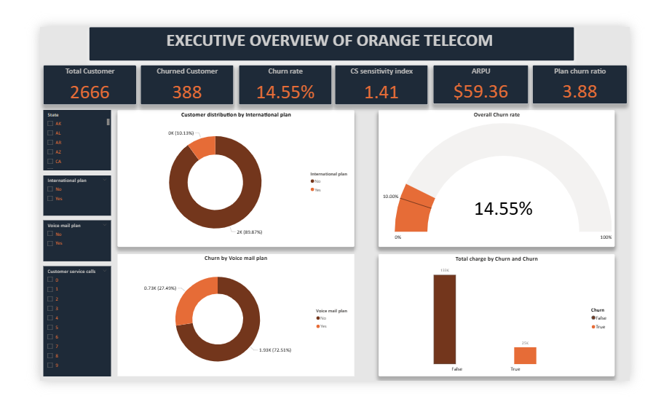
Executive Dashboard Overview

Slide 10
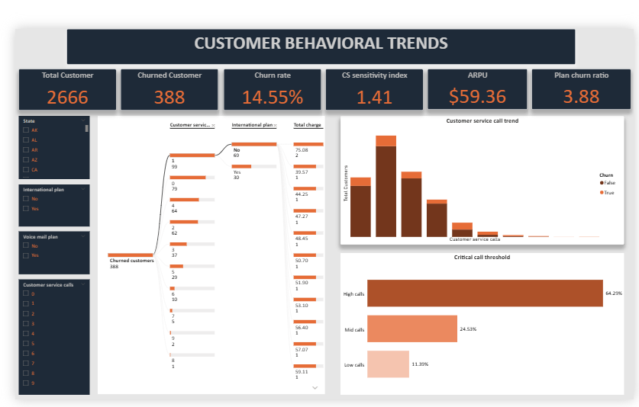
Geographic and Behavioral Churn Insights

Slide 11
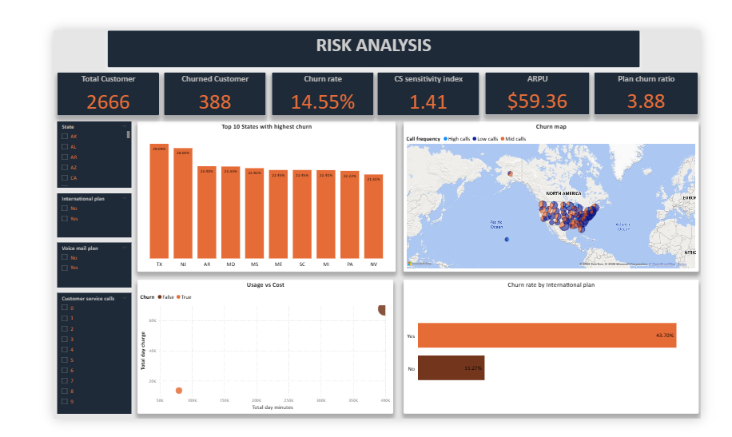
Customer Behavior Deep Dive

Slide 12
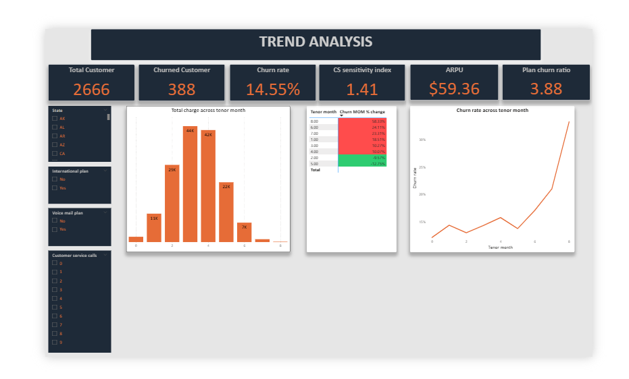
Trend Analysis

